Slide 1
KSNC APP ONLINE KNC REGISTRATION
Karnataka State Nursing Council Bengaluru
Be a Nurse
Your Country Needs You

Slide 2

Workshop on KSNC app online registration
Date:22/08/2025
organized by:
saint Mary’s college
of nursing, H D Kote,
Mysuru- 571114

Slide 3


Introduction
The government of Karnataka has launched a KSNC app for
registration.
If you are registering for the first time, You can do it online through
the app. And for renewal, you must visit the KSNC office Bangalore.
The apps to download are DigiLocker and KSNC.

Slide 4
KNC Registration Online 2025 – Step-by-Step Guide
Alright, here’s the basic flow for KNC registration online:
Go to official portal:
👉 www.knc.karnataka.gov.in
Click on “Online Services” → “Online Registration”
Create your account/login (using email & mobile)
Fill out the application form
Upload your photo, signature, and nursing qualification certificates
Pay registration fee online (via netbanking/card/UPI)
Submit & download acknowledgment slip
Once verified, you can download your KNC Registration Certificate from the portal.

Slide 5
Documents Required for KNC Registration
Nursing course certificate (GNM/BSc/MSc etc.)
Final year marksheets
Internship completion certificate
Aadhaar card
Passport-size photo (recent)
Signature scan
Registration from previous nursing council (if migrating)

Slide 6
📞 KNC Contact Info (just in case)
KNC Office Address:
Karnataka State Nursing Council,
#71, Nightingale Towers,
Lalbagh Road, Bengaluru – 560027
Helpline No: +91 080-22264935
Email: kar.nursingcouncil@gmail.com

Slide 7
KNC Registration Renewal 2025
Yup, your registration isn’t forever. It’s valid for 5 years. So if your KNC ID card is about to expire (or already expired 😬), just do the renewal online:
Visit KNC portal → Login
Go to “Renewal” section
Update your latest work experience details
Pay the renewal fees (around ₹1,000)
Submit application & download renewed certificate
⏳ Pro tip: Don’t wait till the last week to renew. It’s a pain when the site lags.

Slide 8
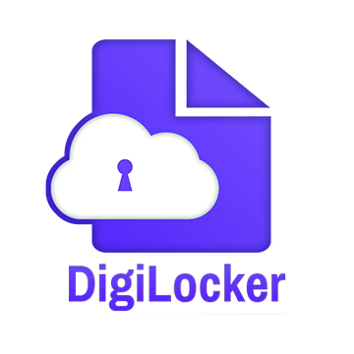
It’s a central government app, that allows citizens to store and access documents and certificates. through this app, you can download your 10th,12th,degree certificate, Aadhar, PAN and other necessary documents. DigiLocker is linked to Aadhar for authentication.

Slide 9
Steps to use KSNC Aadhar & Digilocker App
1. Ensure your mobile number is linked with your Aadhaar, as the KYC
process is OTP-based.
2. Download the Digi Locker app, create your account, and fetch your
SSLC & PUC marks cards from the Karnataka Education & Assessment Board.
3. Download the KSNC App from the Play Store, then register and log in.
4. Perform e-KYC for Aadhaar and Digi Locker within the KSNC App.
5. On the Education page, enter your RGUHS or Nursing Board student
number to get your PDC.
6. Ensure your name in Aadhaar and SSLC matches. If there’s a discrepancy, correct your Aadhaar before performing

Slide 10
7. Once KYC is completed, make the payment for registration. You can use the same login for further services.
8. Check the Dashboard > Notification section in the app for any messages from KSNC. You’ll receive either a KYC issue note or an acknowledgment.
9. You do not need to visit Bangalore KSNC for registration
10. Your registration certificate will be sent to your DigiLocker account, and a hard copy will be mailed to the postal address you provided in the KSNC App.

Slide 11
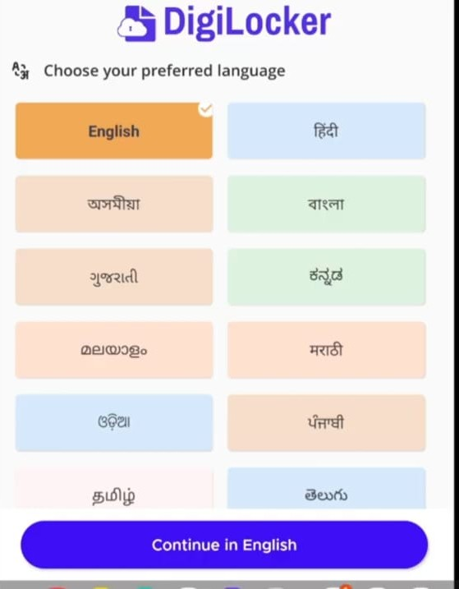
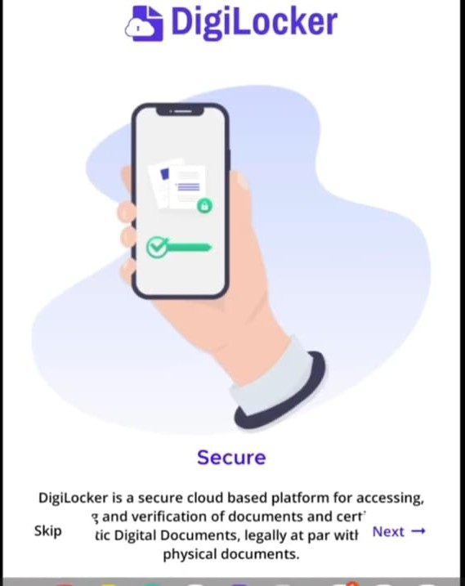
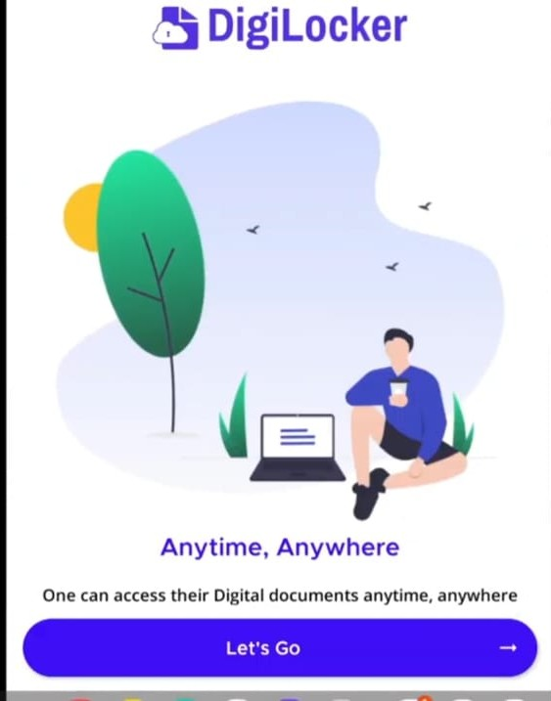
How to create an account in Digilocker
Step 1: Install DigiLocker app from Google play store.
Step 2:Open the app Select your preferred language tap next tap next tap lets go.

Slide 12
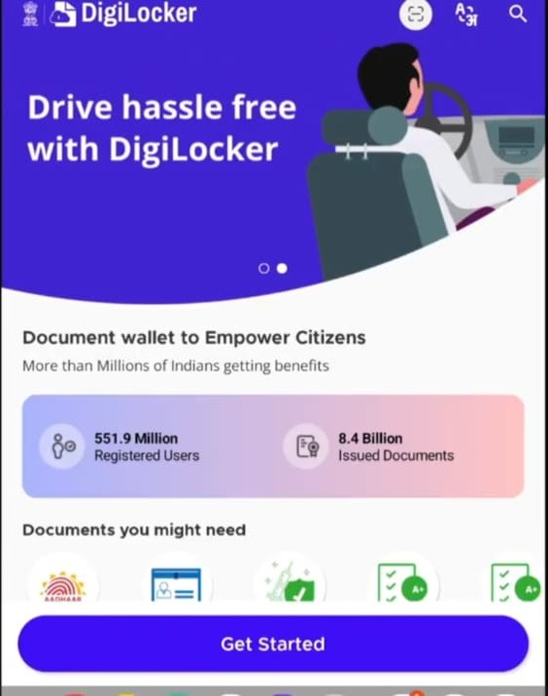
Step 3: The DigiLocker Dashboard will open. Then, click on “Get Started”.

Slide 13
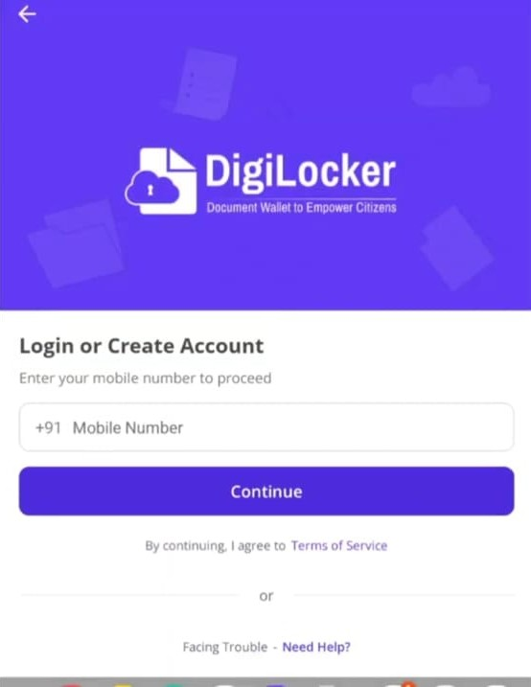
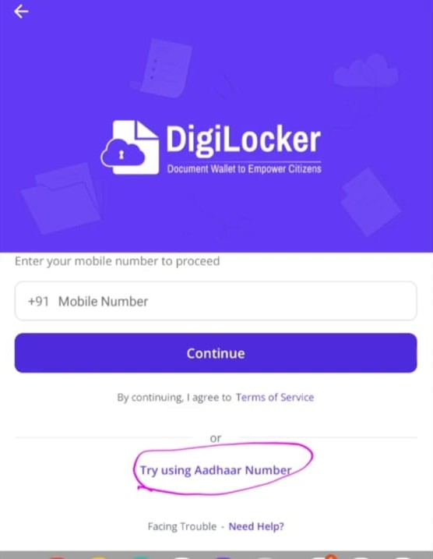
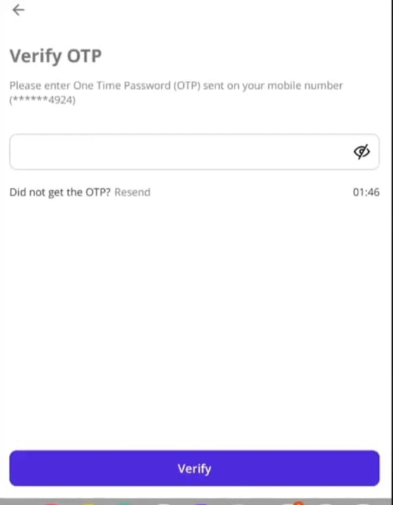
STEP 4: Log in or create an account ( you can log in using a mobile number or Aadhar number). Then tap continue. verify using OTP.

Slide 14
Step 5: After verification, you will be successfully registered. Scroll down again and click on ‘Explore more’. click on ‘Education and and Learning’. scroll down and select your respected educational board download your necessary documents

Slide 15
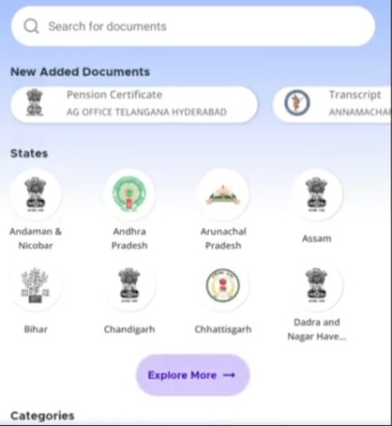
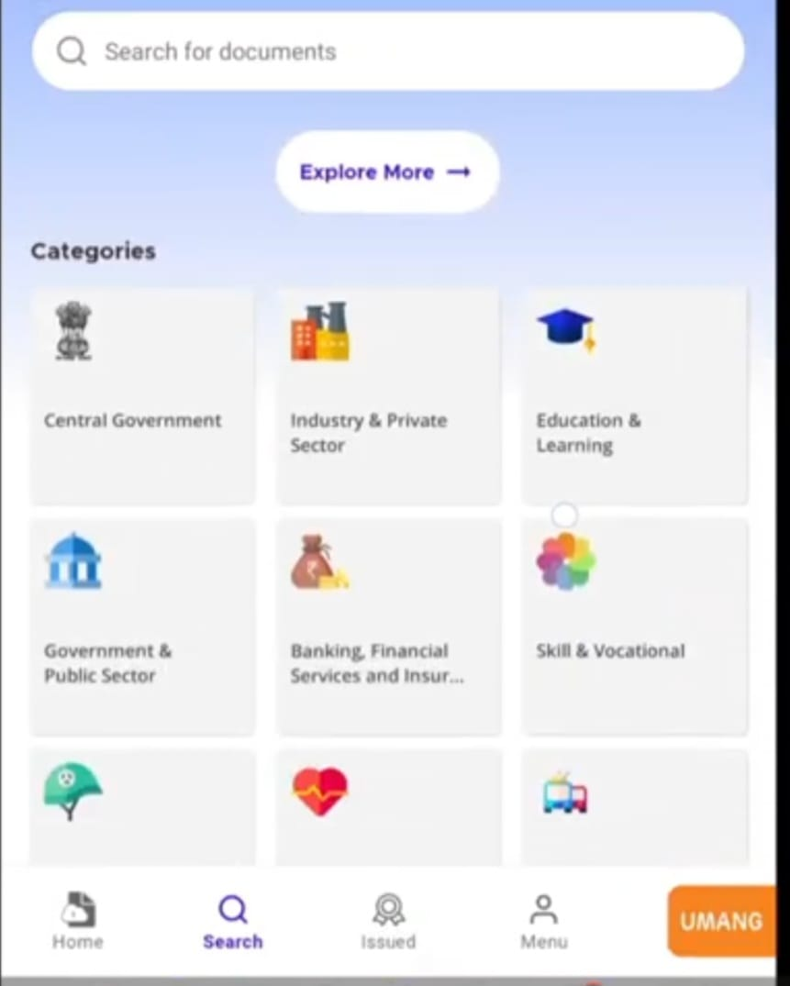
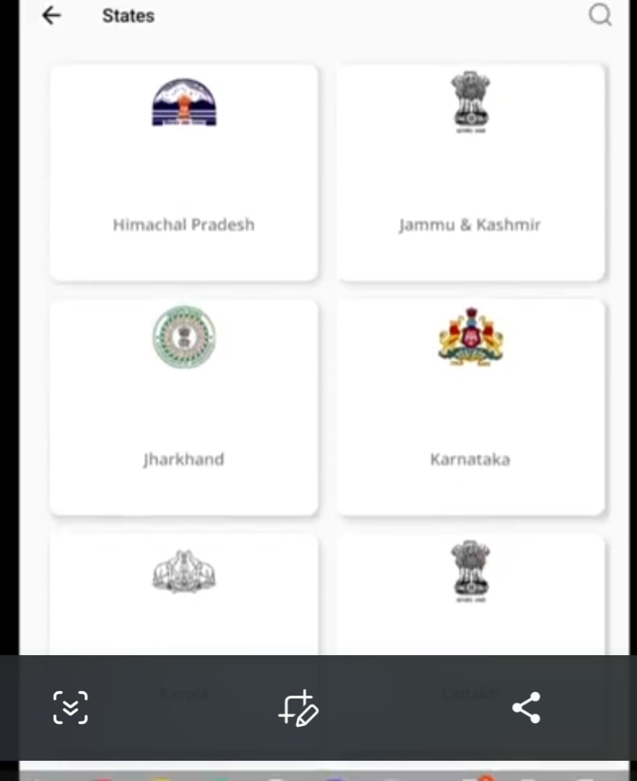
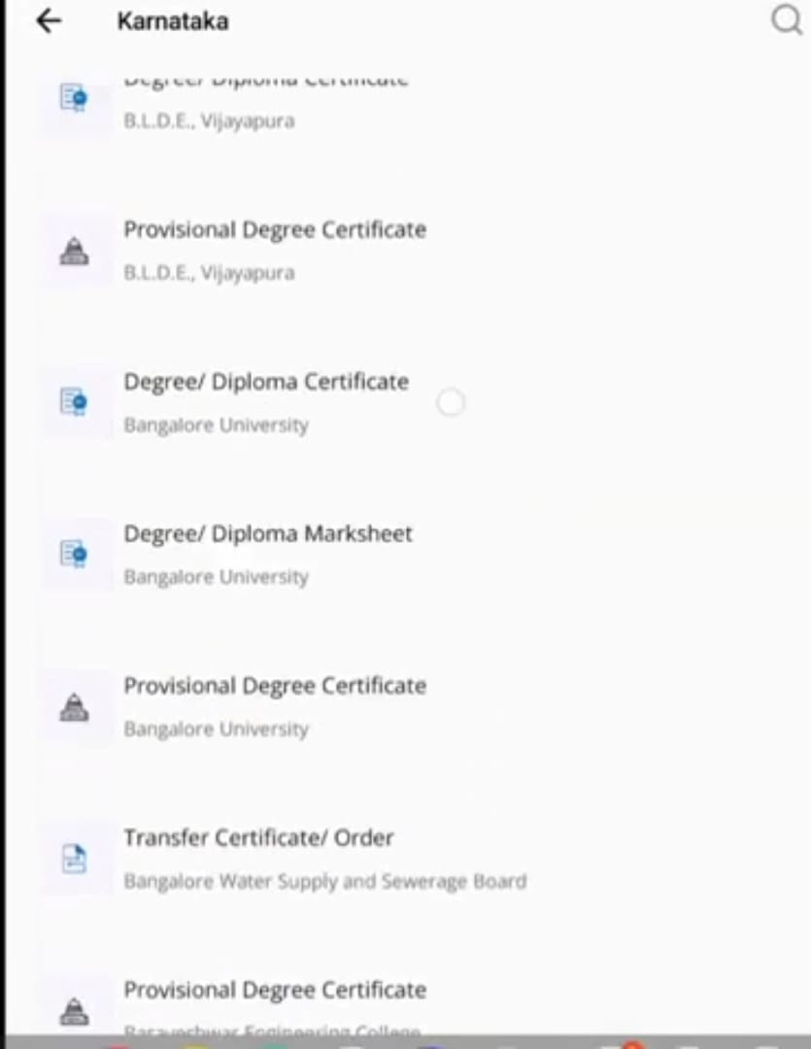
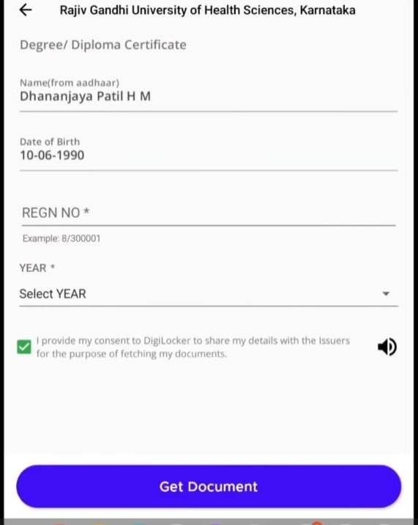

Slide 16
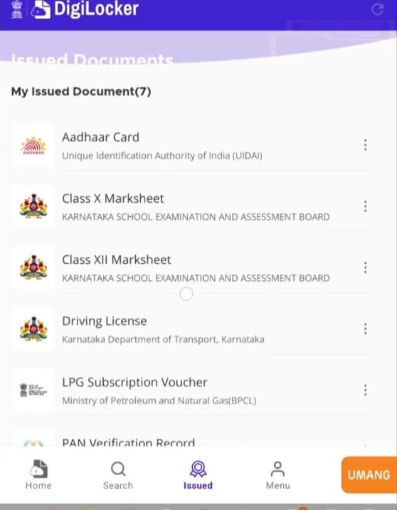
“All the documents you downloaded will be visible in Issued”.

Slide 17
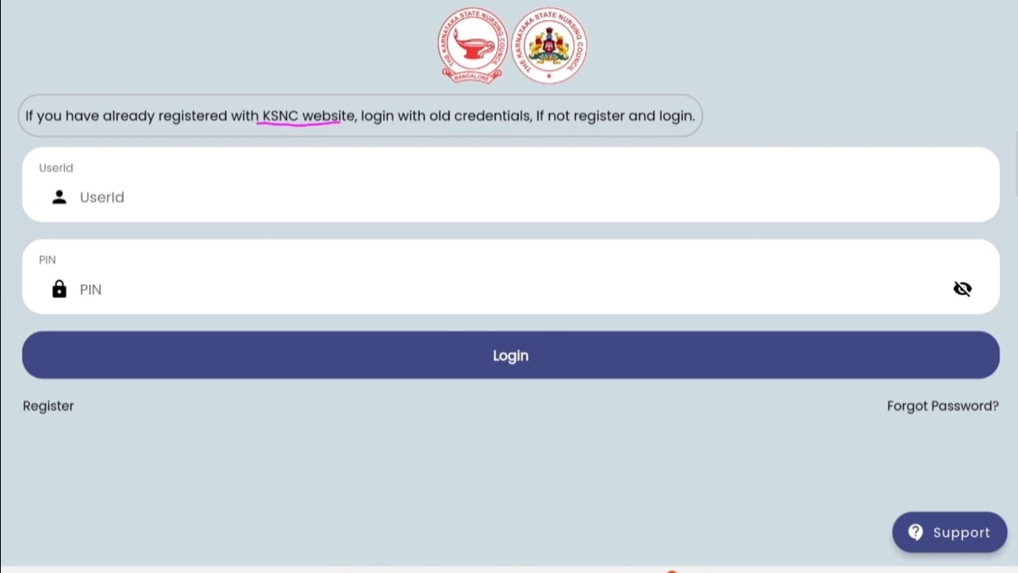
KSNC APP
Install the KSNC app open it.
If you are already registered log in with your old credentials.
If your not registered, complete the registration and log in.
For new registration, click on “Registration”

Slide 18
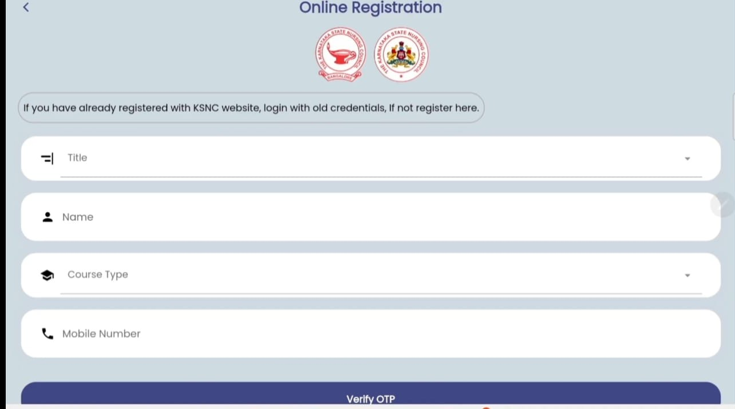
Title: Mr., Ms., Mrs., Dr. Name: Your full name Course type : ANM, GNM, B.Sc., M.Sc. Mobile number: Then click on verify OTP, and you will successfully registered.

Slide 19
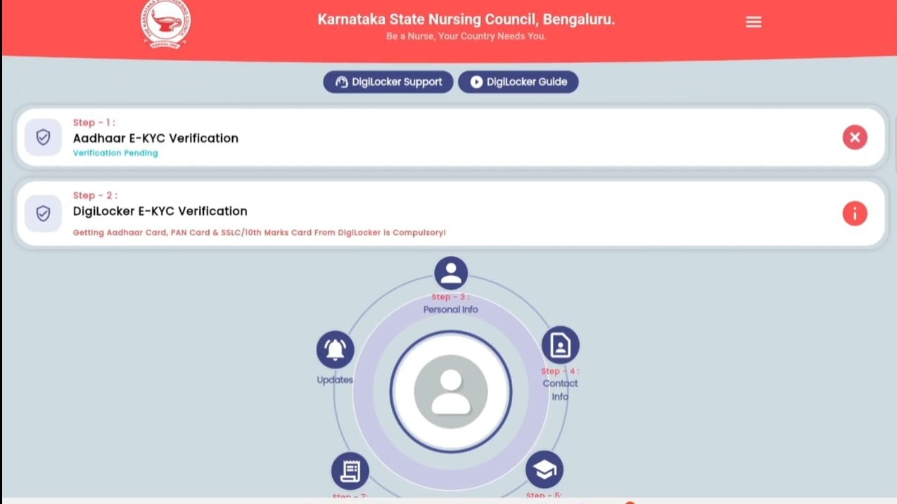
Home page of KSNC Here, you have to do the Aadhaar E-KYC verification and DigiLocker E-KYC verification..

Slide 20
Step 1: Click on Aadhaar e-KYC Proceed to e-KYC Enter your Aadhaar number Scroll down and click on ‘Get OTP’ and enter the OTP you receive. Aadhar e-KYC is successfully completed (you can see your photo on the home page ).

Slide 21
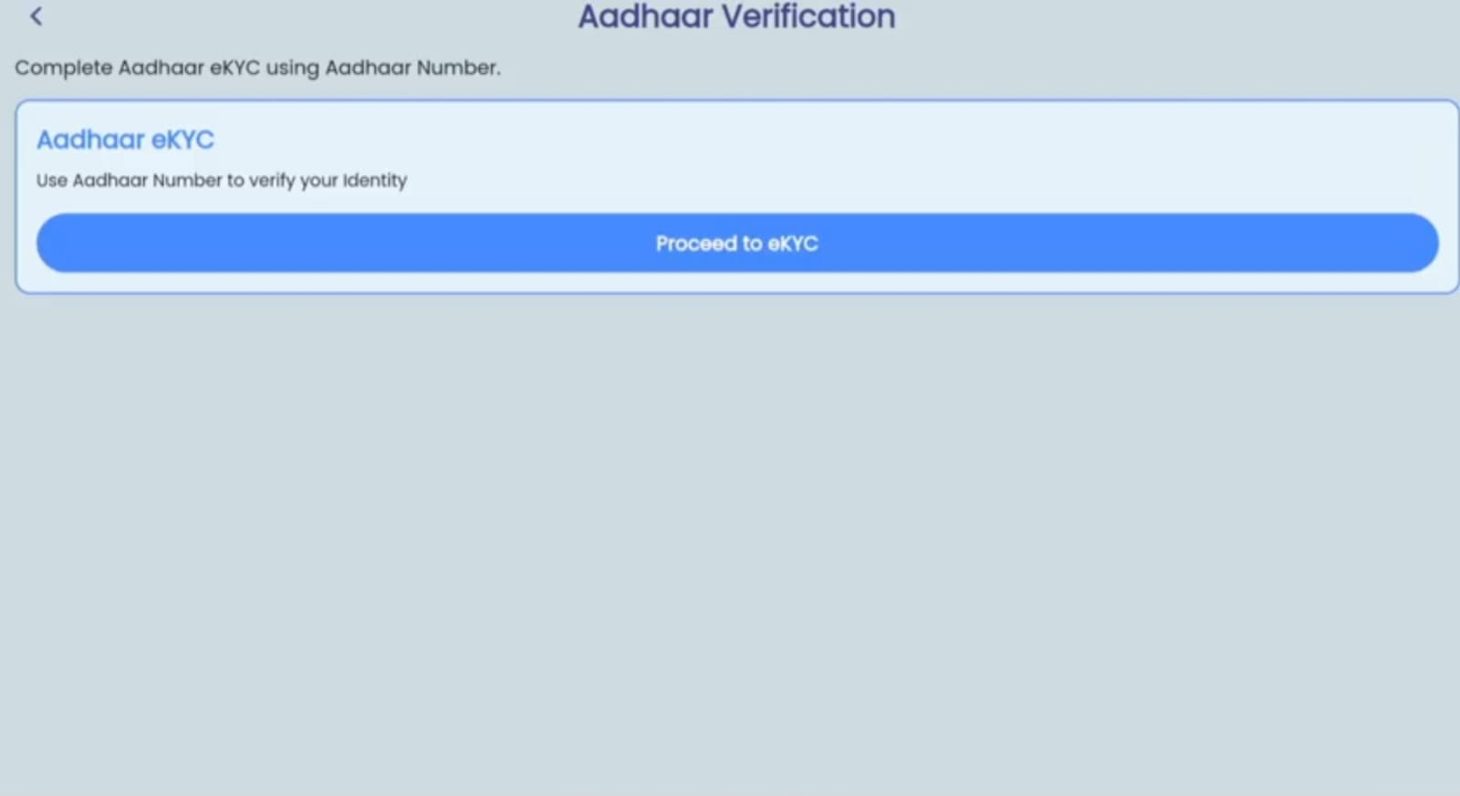
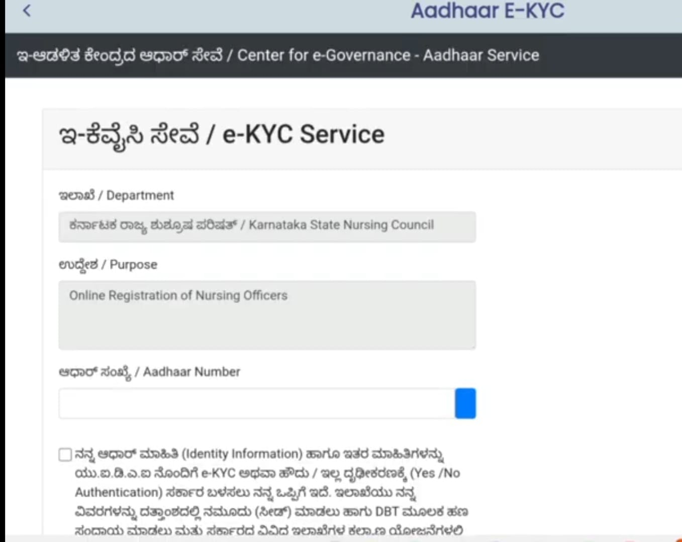
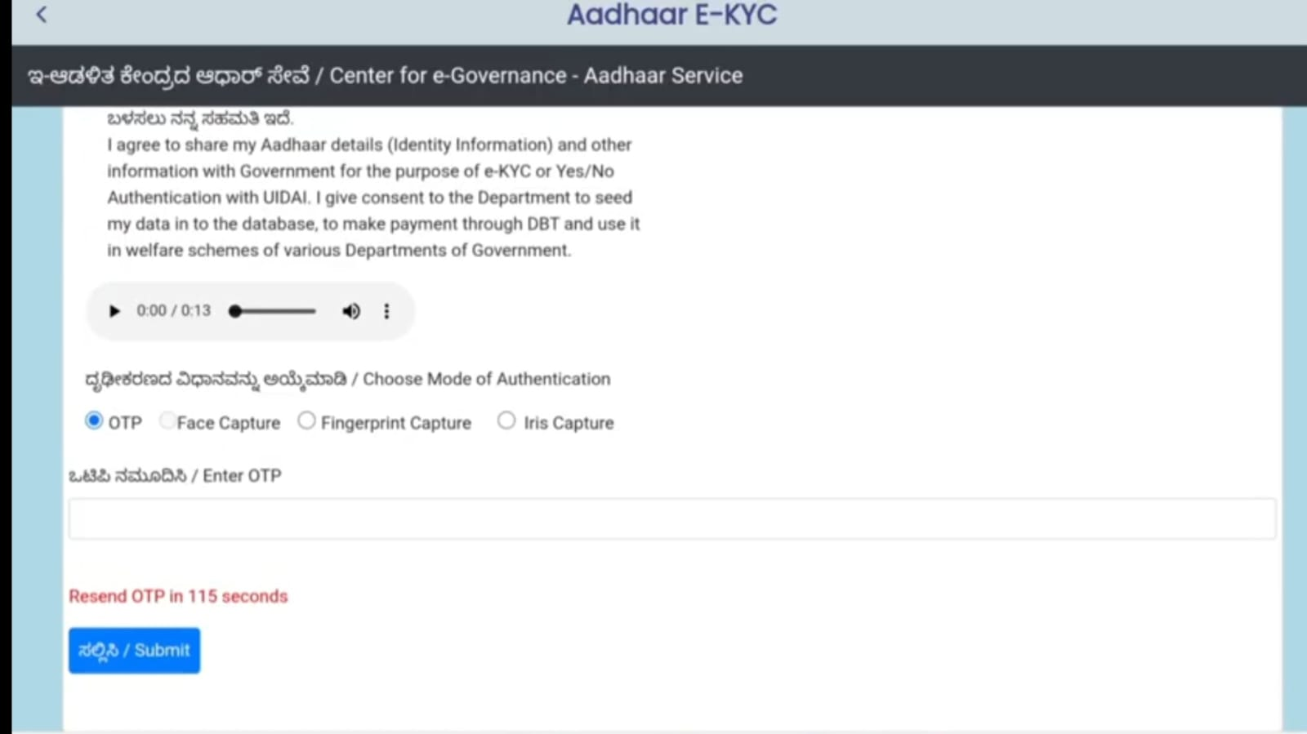
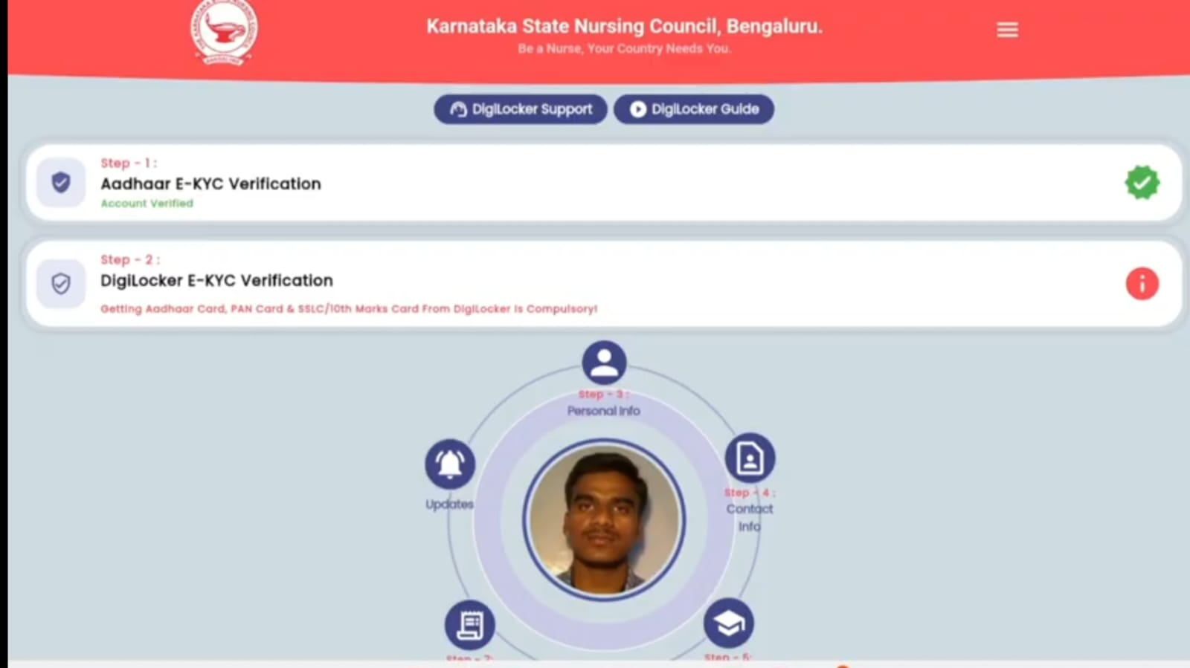

Slide 22
Step 2:
Click on DigiLocker e-KYC verification
Click on ‘proceed’ to e-KYC
Sing up on DigiLocker by using your Aadhaar number(DigiLocker uses Aadhaar number to enable authentic documents access)
Click on next
Enter the Aadhaar OTP sent your Mobile number.
Enter a 6 digit PIN for extra security to your account with two factor authentication. Do not disclose your security PIN to anyone.
Click on ‘done’
Now you can access documents that you have downloaded in DigiLocker.
Select the documents you need and click ‘Allow’.
The first step of DigiLocker e-KYC registration will be successfully completed.

Slide 23
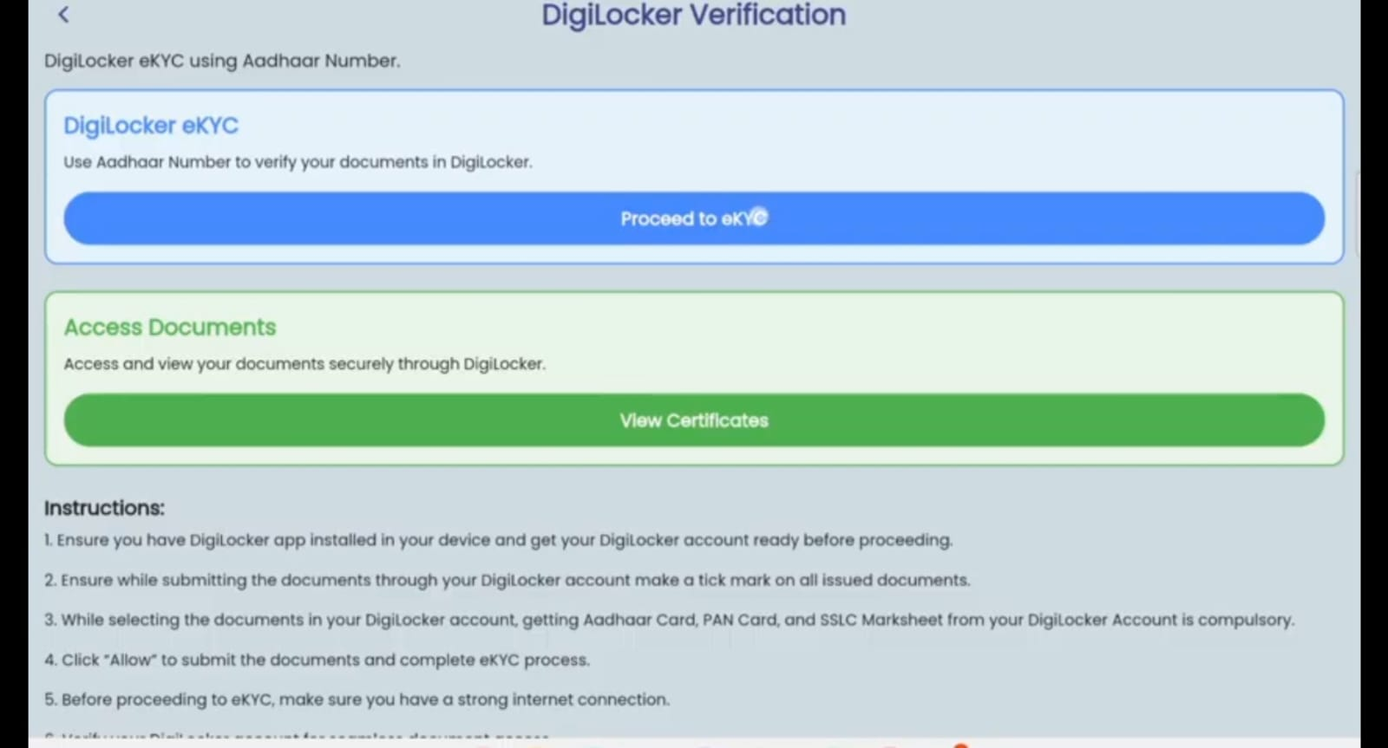
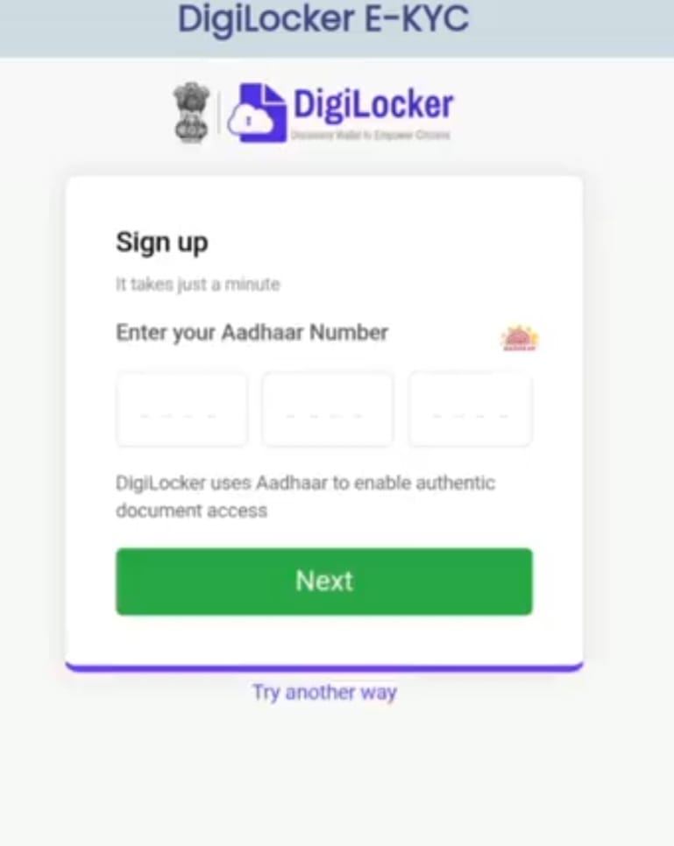
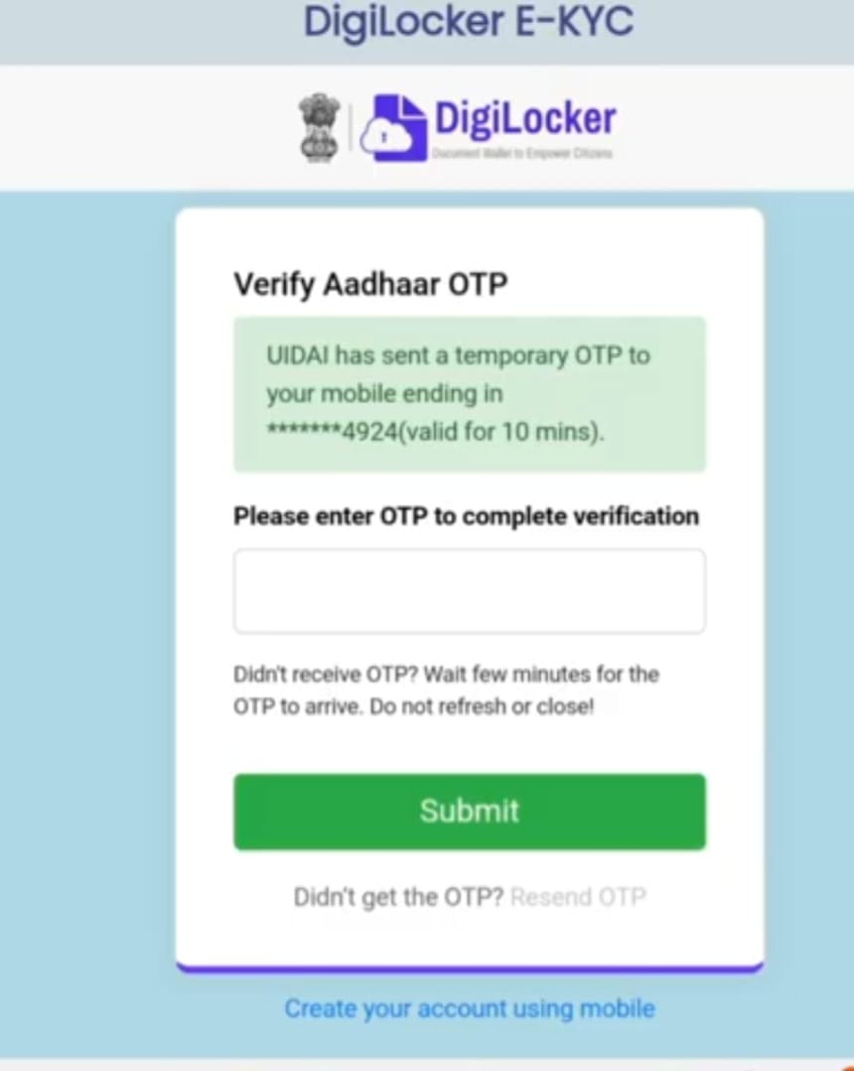

Slide 24
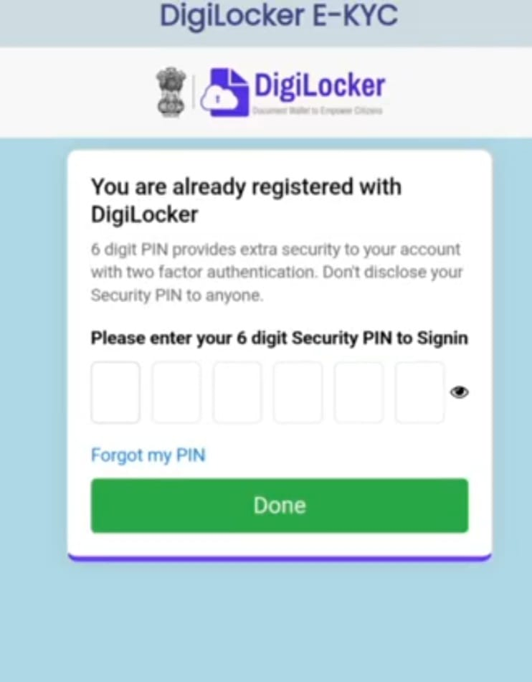
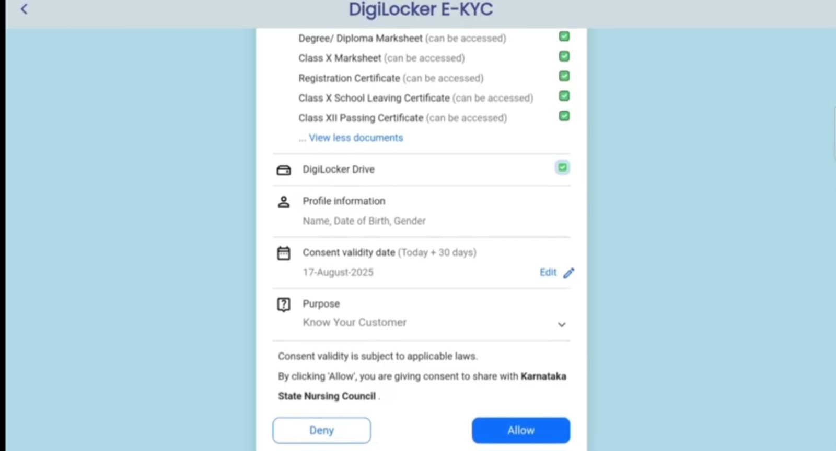
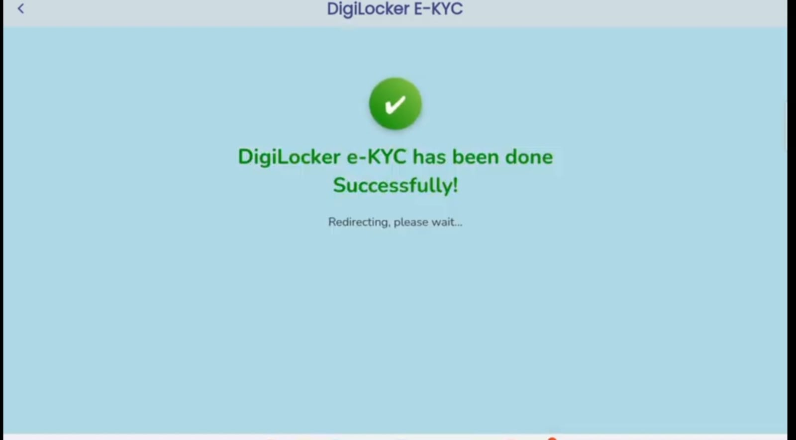

Slide 25
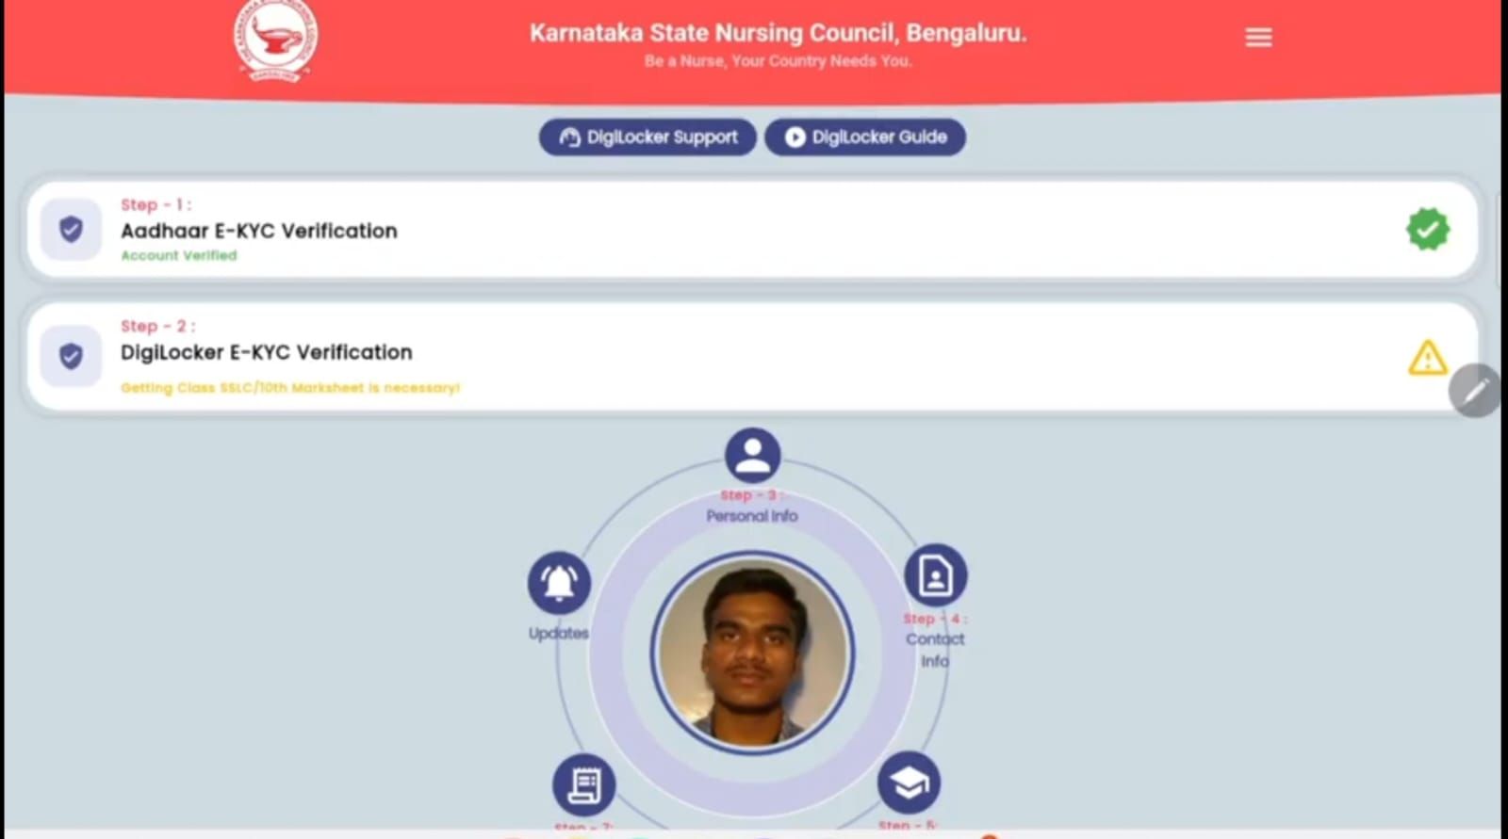
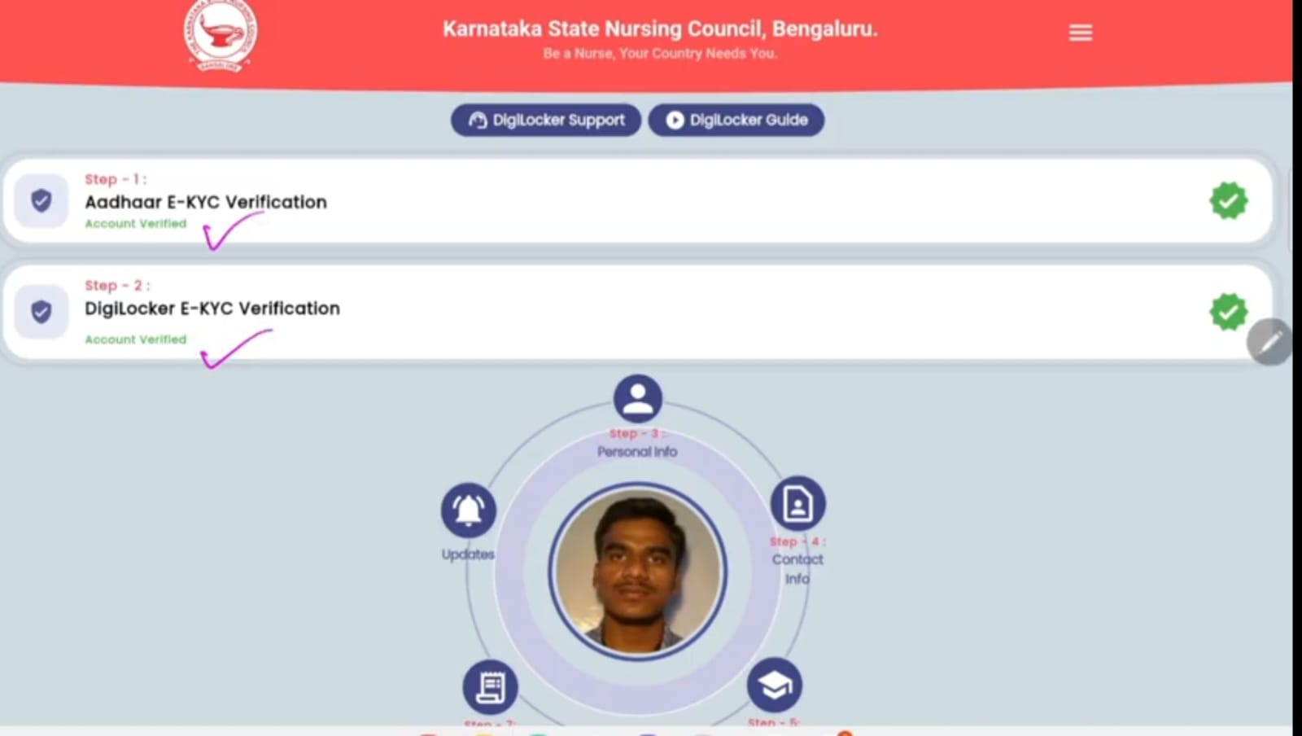
For 2nd step verification
Open the KSNC APP again
Aadhar e-KYC is already done, You can observe a green mark
When it comes to DigiLocker e-KYC, if it shows in yellow, it means it is due and you have to complete the two step verification.
By fallowing same steps as before, you can complete the 1st step digiLocker e-KYC verification.

Slide 26
Step 3: personal information :here you can edit your photo or address if you want Step 4:contact info Step 5:Educational information Step 6: services Step 7: Receipts info Step 8: Updates

Slide 27
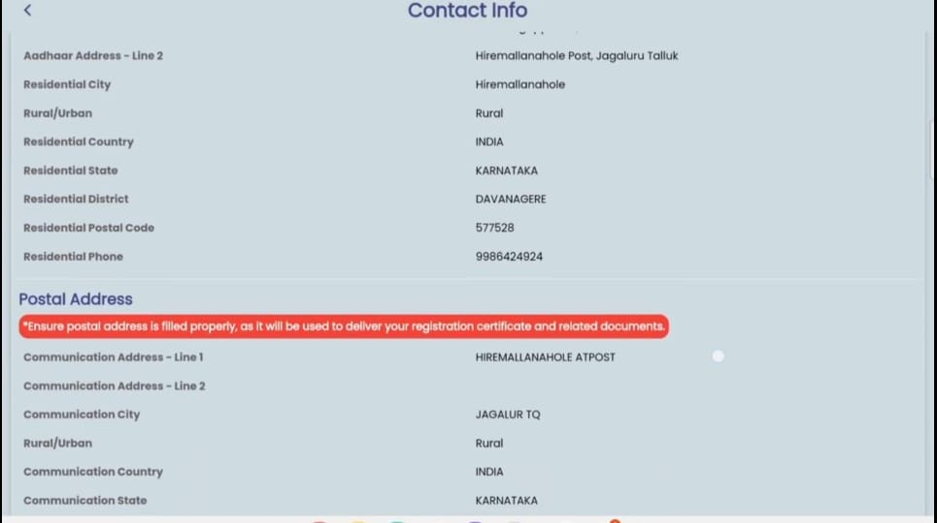
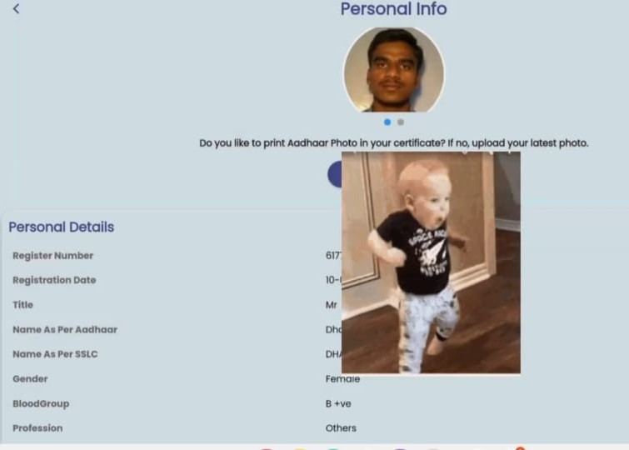
Step 3: personal information :here you can edit your photo or address if you want
Step 4:contact info

Slide 28
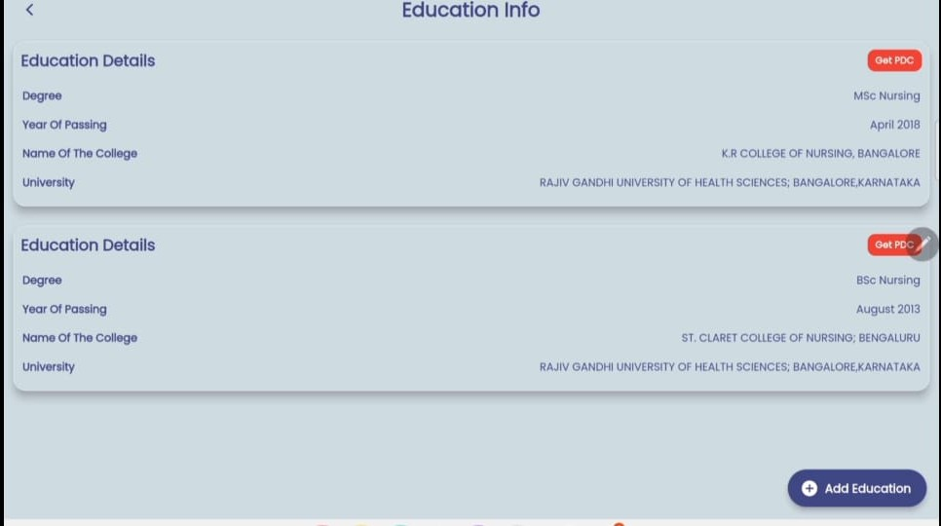
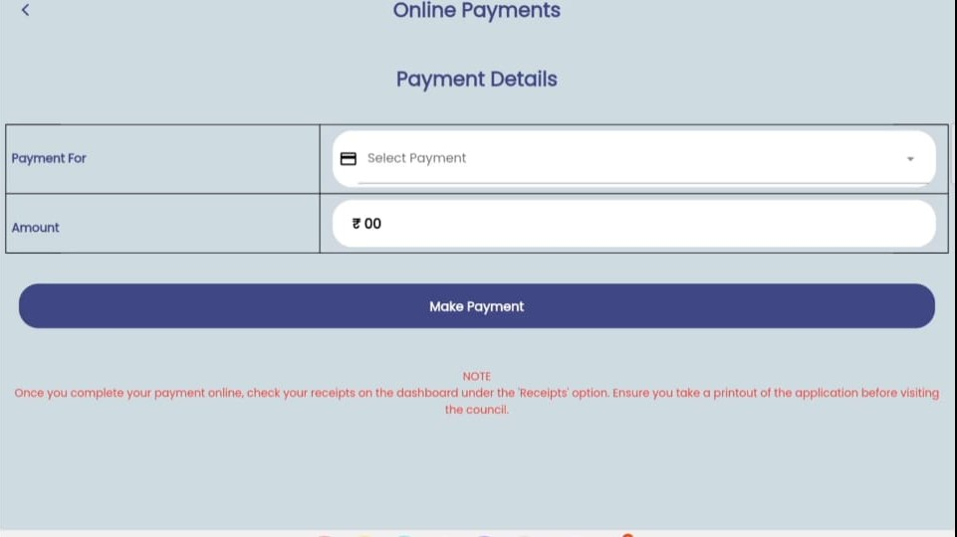
Step 5:Educational information
Step 6: Services

Slide 29
Step 6: services
Click on ‘services’ (the payment details screen will open ).
Click on drop- down arrow icon in front of select payment.
There will be many options displayed.
Scroll down and find ‘Permanent registration(for those who are registering for first time ) and click on it.(filling registration with nursing certificate, ID proof, passport photo and personal educational details).
RR GNM ,RR B.Sc. (reciprocal GNM and B.Sc.) means that those who have done nursing in other state and coming to Karnataka can click on RR GNM OR
B .Sc.
Then make payment.(pay via Online gateway- UPI, Card, Net Banking) Receive payment receipt instantly.
Then your registration will be successfully completed.
Track application progress: Pending– Verified—Approved
Download e-certificate after approval.

Slide 30
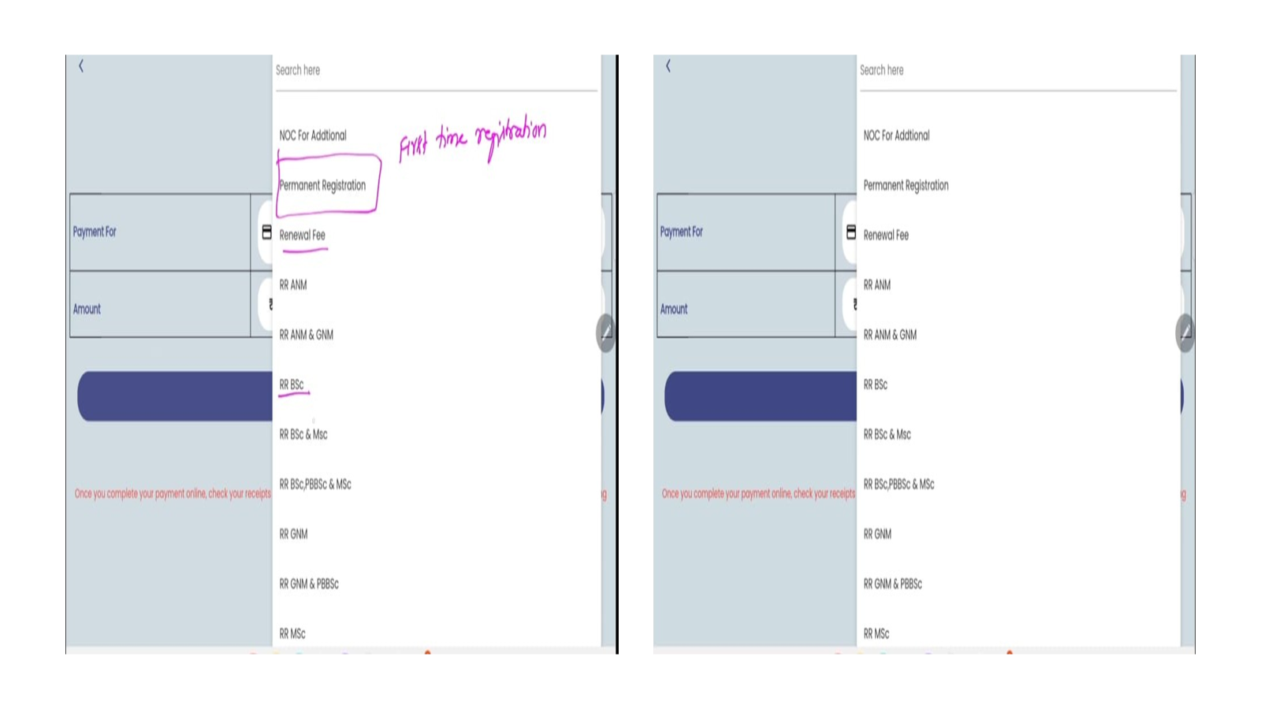

Slide 31
Step 7: Receipts info
Your view your payment history in the ‘Receipt info’ section
. Step 8: Updates(notification and all updates regarding the documents and registration)

Slide 32
Thank you

